Slide 1

ANOMALY DETECTION IN IOT SYSTEMS USING UNSUPERVISED LEARNING
22AIE213- Machine Learning
TEAM 13
CH.SC.U4AIE23017 – G Rahul
CH.SC.U4AIE23056 – T Balaji
CH.SC.U4AIE23063 – N Lakshmi Jayanth Reddy

Slide 2
Literature Review

Slide 3
S.NO​ ​ | Title​ ​ | Citation Number ​ | Methodology​ ​ | Pros ​ | Cons ​ | Research gap​ ​
1 2 3 4 5 | Deep Learning-Enabled Anomaly Detection for IoT Systems. Anomaly Detection in Industrial Machinery Using IoT Devices and Machine Learning: A Systematic Mapping Securing Constrained IoT Systems: A Lightweight ML Approach for Anomaly Detection and Prevention A Comparative Analysis of Various ML Methods for Anomaly Detection in Cyber Attacks on IoT Networks. Enhancing IoT Security: Optimizing Anomaly Detection through ML | https://doi.org/10.1016/j.iot.2022.100656 https://doi.org/10.1109/ACCESS.2023.3333242 https://doi.org/10.1016/j.iot.2024.101398 https://doi.org/10.1016/j.iot.2024.101162 https://doi.org/10.3390/electronics13112148 | Uses a deep learning model based on a denoising autoencoder to detect anomalies in IoT systems. Systematic mapping study evaluating 84 studies on ML-based anomaly detection for industrial IoT Uses TinyML with Decision Tree and Edge AI to detect resource-constrained attacks in IoT devices Compares SVM, ANN, Decision Tree, k-NN, and Logistic Regression on ToN-IoT and BoT-IoT datasets Evaluates XGBoost, SVM, and DCNN on IoT-23, NSL-KDD, and ToN-IoT datasets | Robust feature extraction Improves anomaly detection accuracy Identifies key algorithms and challenges Provides a comprehensive review Low energy and memory footprint High detection accuracy (96.9%) Provides comparative insights on different ML models Neural Networks performed best XGBoost achieves 99.98% accuracy High efficiency compared to SVM and DCNN | Computationally expensive Requires labeled training data Limited real-world validation Lacks a specific proposed model Limited to specific attack types May not scale well for larger IoT networks. Lacks real-time testing No hybrid or ensemble learning models tested May not generalize well to all IoT use cases Requires extensive computational resources | Lack of real-time deployment cases High complexity in heterogeneous IoT environments No practical framework proposed Future research needed for real-time industrial IoT applications More studies needed on adaptive models Needs real-world deployment in diverse IoT environments. Requires further study on hybrid approaches Needs evaluation on edge-based IoT environments Lacks real-time evaluation on IoT edge devices Needs further studies on resource-efficient ML models

Slide 4
S.NO​ ​ | Title​ ​ | Citation Number ​ | Methodology​ ​ | Pros ​ | Cons ​ | Research gap​ ​
6 7 8 9 10 | Anomaly Detection for IoT Systems Using Active Learning Anomaly Detection in a Smart Industrial Machinery Plant Using IoT and Machine Learning XAI-IoT: An Explainable AI Framework for Enhancing Anomaly Detection in IoT Systems Optimizing Security in IoT Ecosystems Using Hybrid Artificial Intelligence and Blockchain Models Intrusion Detection and Prevention System (IDPS) Model for IIoT Environments Using Hybridized Framework | https://doi.org/10.3390/app132112029 https://doi.org/10.3390/s23198286 https://doi.org/10.1109/ACCESS.2024.3402446 https://doi.org/10.1109/ACCESS.2025.3532800 https://doi.org/10.1109/ACCESS.2025.3538461 | Uses active learning with a random forest classifier on UNSW-NB15 dataset for anomaly detection. Collects sensor and IoT camera data in an industrial plant and uses ML models (SVM, CNN) for anomaly detection. Uses Explainable AI (XAI) with ML models (DNN, SVM, AdaBoost) for IoT anomaly detection and feature importance analysis. Combines AI and blockchain for intrusion detection and authentication in IoT networks. Uses CNNs for intrusion detection and blockchain-assisted reinforcement learning (RL) for dynamic threat mitigation. | - Eliminates the need for extensive labeling - Adapts to dynamic IoT environments - High accuracy (99.7%) - Reduces false positives by 3% - Improves anomaly detection by 13% - Provides feature importance analysis - Uses real-world datasets (IoT-based manufacturing and IoT botnet attacks) - Reduces authentication latency by 66.6% - Lowers energy consumption by 31.8% - Adapts to evolving cyber threats - Uses RL for autonomous intrusion prevention | - Computationally expensive - Requires an iterative learning approach - High dependency on IoT infrastructure - Real-time performance not extensively tested - High complexity of XAI models - Not tested in real-time IoT edge environments - High computational demands for blockchain - Limited testing on large-scale networks - High false positive rates - Blockchain integration may slow response times | - Needs validation on real-world IoT networks - Scalability of active learning for large IoT datasets remains untested - Lacks validation in different industrial environments - No hybrid AI models considered for further improvement - Needs further research on integrating XAI with lightweight IoT models - Lacks studies on the impact of XAI on intrusion response times - Needs more real-world testing with 5G and LoRa environments - Scalability of blockchain in IoT security is unexplored - Needs optimization to reduce computational load - Further study required for scaling RL models in IIoT networks

Slide 5
S.NO​ ​ | Title | Citation Number | Methodology​ | Pros​ | Cons | Research gap​
11 12 13 14 15 | DL-ADS: Improved Grey Wolf Optimization Enabled AE-LSTM Technique for Efficient Network Anomaly Detection in IoT Edge Computing Detection of Real-Time Malicious Intrusions and Attacks in IoT Empowered Cybersecurity Infrastructures Intrusion Detection in IoT Systems Using Denoising Autoencoder A Comprehensive Approach to Intrusion Detection in IoT Environments Using Hybrid Feature Selection and Multi-Stage Classification Techniques Self-Adaptive Traffic Anomaly Detection System for IoT Smart Home Environments | https://doi.org/10.1109/ACCESS.2024.3405628 https://doi.org/10.1109/ACCESS.2023.3238664 https://doi.org/10.1109/ACCESS.2024.3451726 https://doi.org/10.1109/ACCESS.2025.3532895 https://doi.org/10.23919/transcom.2024EBT0002 | Uses Improved Grey Wolf Optimization (IGWO) with AE-LSTM for network anomaly detection in IoT edge computing. Uses Generative Adversarial Networks (GAN) for detecting cyber threats in IoT-driven cybersecurity infrastructures. Uses Denoising Autoencoder (DAE) to detect anomalies in IoT networks, tested on CICIDS2017 and NSL-KDD datasets. Combines Quantum-Inspired Particle Swarm Optimization (QIPSO) with Capsule Networks and Attention-Augmented RNNs for intrusion detection. Uses a self-adaptive anomaly detection system with a honeypot server and real-time traffic analysis for IoT smart homes. | - High accuracy (99.11%) - Optimized hyperparameters improve LSTM performance - Improves accuracy (97%) for intrusion detection - Tested on NSL-KDD, KDDCup99, and UNSW-NB15 datasets - High accuracy (99.991%) - Effective feature extraction for anomaly detection - Outperforms state-of-the-art IDS techniques - Achieves 98.83% accuracy on TON-IoT dataset - Real-time adaptability to evolving cyber threats - Uses dynamic model updates for anomaly detection | - Limited real-world deployment validation - High computational cost for large-scale IoT networks - High false positive rates - Requires high computing resources - High training time - Performance on real-time IoT data is unverified -High resource consumption - Not tested for real-time adaptive learning - High reliance on honeypot server accuracy - Needs extensive testing in diverse IoT environments | -Needs further study on energy -efficient AI models for IoT edge - Needs real-time evaluation in industrial IoT networks - Scalability of GAN-based IDS remains unexplored - Requires real-world implementation to validate effectiveness - Needs adaptive learning for evolving attack patterns - Requires further testing on energy-constrained IoT devices - Needs more scalable implementation strategies - Further study needed on improving scalability - Requires evaluation on industrial IoT settings

Slide 6
S.NO​ ​ | Title​ ​ | Citation Number ​ | Methodology​ ​ | Pros ​ | Cons ​ | Research gap​ ​
16 17 18 19 20 | Toward Intelligent Monitoring in IoT: AI Applications for Real-Time Analysis and Prediction Interpretable Rule Mining for Real-Time ECG Anomaly Detection in IoT Edge Sensors Secure Healthcare Access Control System (SHACS) for Anomaly Detection and Enhanced Security in Cloud-Based Healthcare Applications Novel Framework for an Intrusion Detection System Using Multiple Feature Selection Methods Based on Deep Learning Optimizing Smart Home Intrusion Detection With Harmony-Enhanced Extra Trees | https://doi.org/10.1109/ACCESS.2024.3376707 https://doi.org/10.1109/JIOT.2023.3260722 https://doi.org/10.1109/ACCESS.2024.3492024 https://doi.org/10.26599/TST.2023.9010032 https://doi.org/10.1109/ACCESS.2024.3422999 | Uses IoT sensors with AI-based predictive analytics to monitor and detect anomalies in real-time industrial environments. Uses rule-based AI and feature selection for ECG anomaly detection in IoT edge sensors, reducing power consumption. Uses role-based and rule-based access control with real-time anomaly detection for securing Electronic Health Records (EHR). Uses deep learning with multi-feature selection techniques to improve IDS performance in IoT networks. Uses Harmony Search Algorithm (HSA) to optimize Extra Trees Classifier (ETC) for smart home intrusion detection. | - High detection accuracy (98.7%) - Proactive anomaly detection reduces operational failures - High sensitivity (90%) for abnormal beats - Explainable AI model enhances trust in healthcare applications - Reduces authentication time by 30% - Enhances data security for cloud-based healthcare systems - Low false positive rate - High accuracy in detecting network intrusions - Achieves 99.87% accuracy - Low false alarm rate | - High computational demand - Not tested in diverse industrial settings - Limited to ECG anomaly detection - Not generalized for other medical conditions - High dependency on policy configurations - Potential scalability issues for large hospitals - High resource consumption - Not evaluated for real-time adaptability - Requires extensive hyperparameter tuning - Limited scalability for large IoT networks | Needs optimization for real-time adaptation in large-scale IoT environments - Needs real-world deployment and further validation in diverse patient groups - Requires validation in real-world healthcare systems - Needs optimization for low-latency access in emergency scenarios - Needs further studies on lightweight IDS models for resource-constrained IoT devices - Needs real-world testing on diverse smart home ecosystems - Requires further evaluation in hybrid security frameworks

Slide 7
Problem Identification
Issue Addressed:
The increasing deployment of IoT devices across industries has led to vast amounts of sensor data being generated in real time.
These IoT systems are vulnerable to anomalous events due to cyberattacks, sensor malfunctions, or environmental changes.
Traditional anomaly detection methods struggle to detect subtle, complex patterns in high-dimensional data.
Gaps/Challenges Identified in Literature:
Rule-based anomaly detection methods lack adaptability and fail to generalize across diverse IoT environments.
Conventional machine learning models require labeled data, which is scarce for anomalies.
Deep learning-based approaches require high computational resources, making them impractical for real-time IoT applications.

Slide 8
Agenda
Problem Statement
Clear Problem Description:
IoT systems continuously generate real-time sensor data, but detecting anomalies in such large-scale, high-dimensional data is challenging.
Existing detection techniques either fail to generalize across different IoT environments or require extensive labeled data, which is impractical.
Solution Approach:
This research aims to overcome the limitations of traditional anomaly detection methods by introducing an autoencoder-based deep learning approach that learns patterns from normal IoT sensor data and effectively identifies anomalies without requiring labeled data.

Slide 9
Objective
To develop a anomaly detection system for IoT networks using deep learning techniques.
To implement an autoencoder-based deep learning model that learns normal behavior and identifies deviations as anomalies.
To establish an anomaly detection threshold based on reconstruction error analysis.
To evaluate the system's performance on multiple datasets for robustness and generalization.

Slide 10
Introduction
The rapid expansion of IoT systems across various industries has resulted in an enormous influx of real-time sensor data. However, these systems are highly susceptible to anomalies caused by cyberattacks, sensor failures, and environmental variations. Traditional anomaly detection techniques struggle to effectively identify subtle and complex deviations due to their reliance on predefined rules or labeled data.
To address these challenges, our research focuses on leveraging deep learning-based autoencoders for real-time anomaly detection in IoT networks. This approach enables the model to learn normal patterns from sensor data and detect anomalies without requiring labeled datasets. By implementing this system, we aim to enhance the security, reliability, and efficiency of IoT infrastructures.

Slide 11
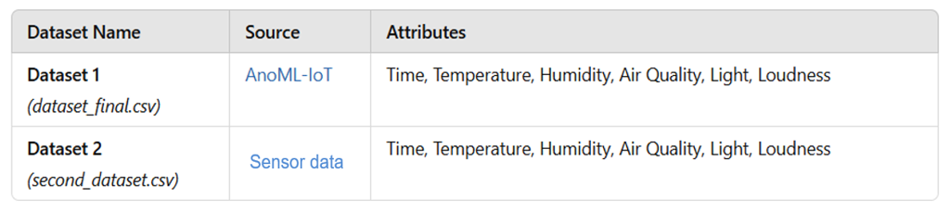

Dataset Used

Slide 12
Hardware and Software Requirements
Hardware Requirements
Processor: Intel i5/i7 or higher, AMD Ryzen 5/7
RAM: Minimum 8GB (Recommended 16GB for faster training)
Storage: Minimum 50GB free disk space
GPU (Optional): NVIDIA GTX 1650 or better (for deep learning acceleration)
Software Requirements
Programming Language: Python
Libraries: TensorFlow, Keras, NumPy, Pandas, Scikit-learn, Matplotlib
IDE: Jupyter Notebook / PyCharm / VS Code
Data Science Tools: Google Colab (for cloud-based model training)

Slide 13
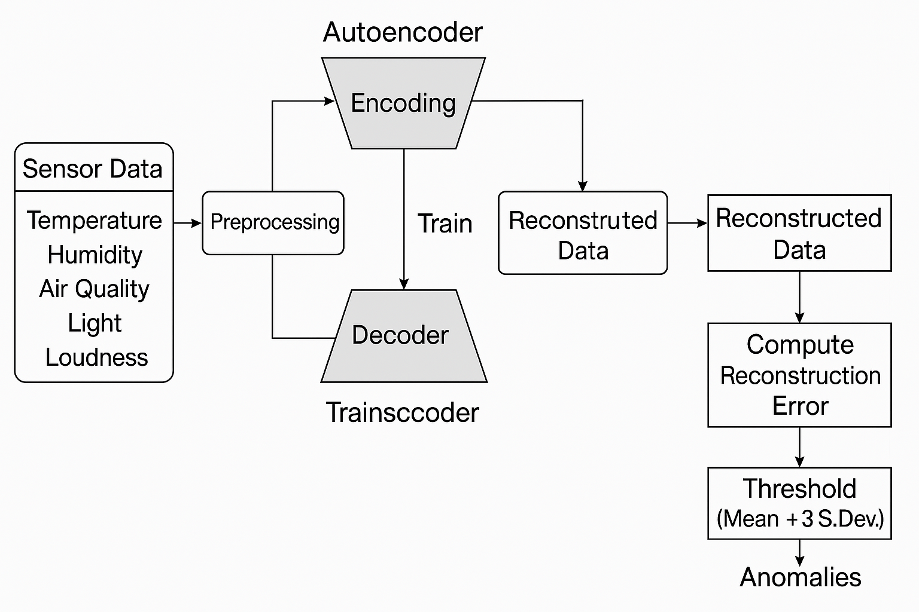
Architecture of Autoencoder Model

Slide 14
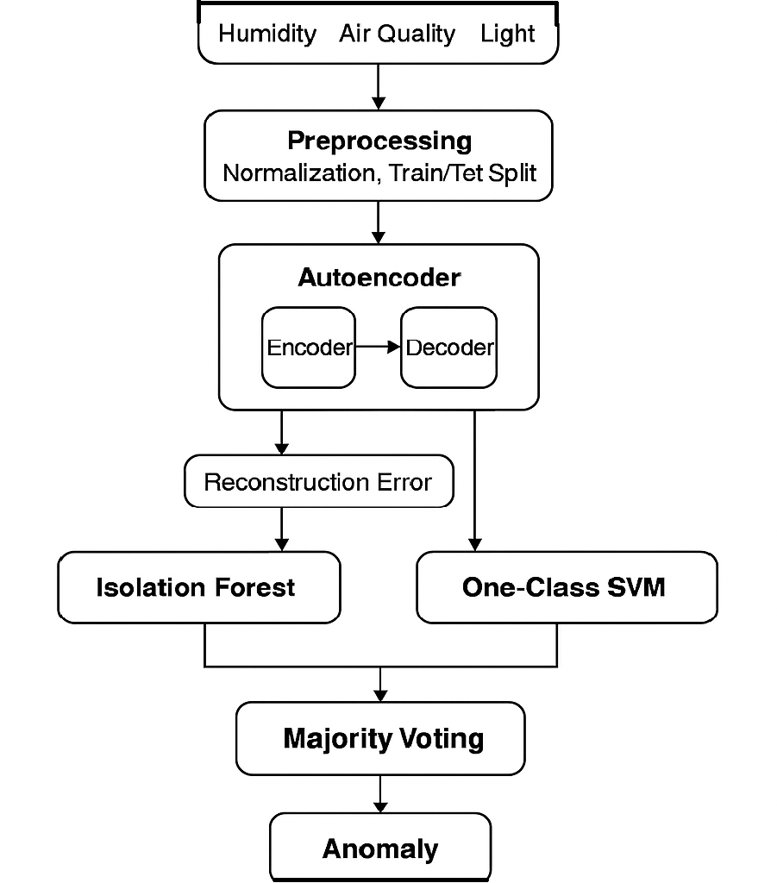
Architecture of Hybrid Model

Slide 15
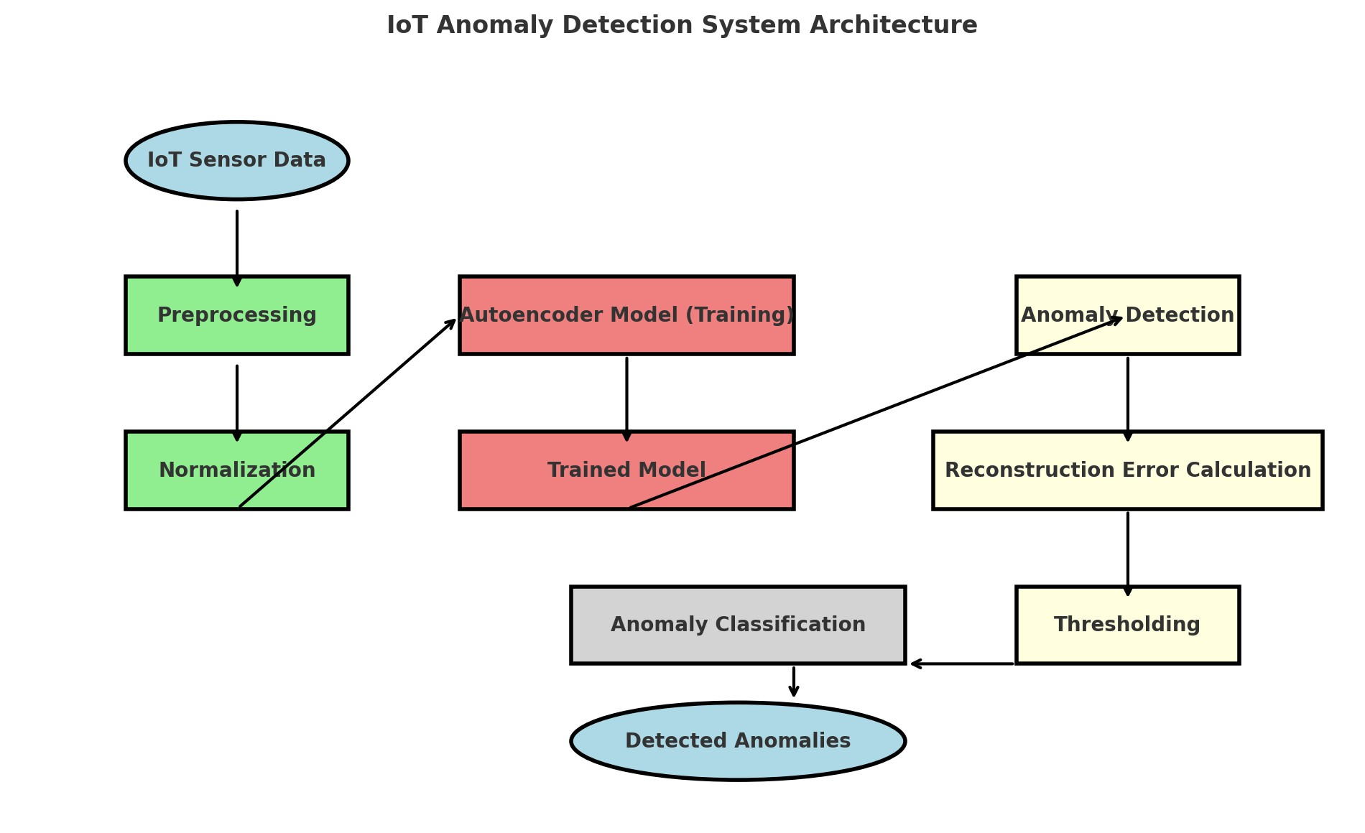
Work Flow of our System

Slide 16
THANK YOU

